Slide 1

Introduction to Coding
Scratch
Produced
by:
Dr. Siobhán Drohan
Mairead Meagher
Department of Computing and Mathematics
http://www.wit.ie/

Slide 2
Topics list
What is Scratch?
Flow of Control in a Program
SomethingFishy Examples:
Example1: Sequence
Example2: Sequence, Selection and Iteration.
Example3: Sequence, Selection and Iteration.

Slide 3
Topics list
What is Scratch?
Flow of Control in a Program
SomethingFishy Examples:
Example1: Sequence
Example2: Sequence, Selection and Iteration.
Example3: Sequence, Selection and Iteration.

Slide 4
Scratch
Scratch is a graphical coding language.
Developed to help students understand coding.
You code in the Scratch editor.

Slide 5
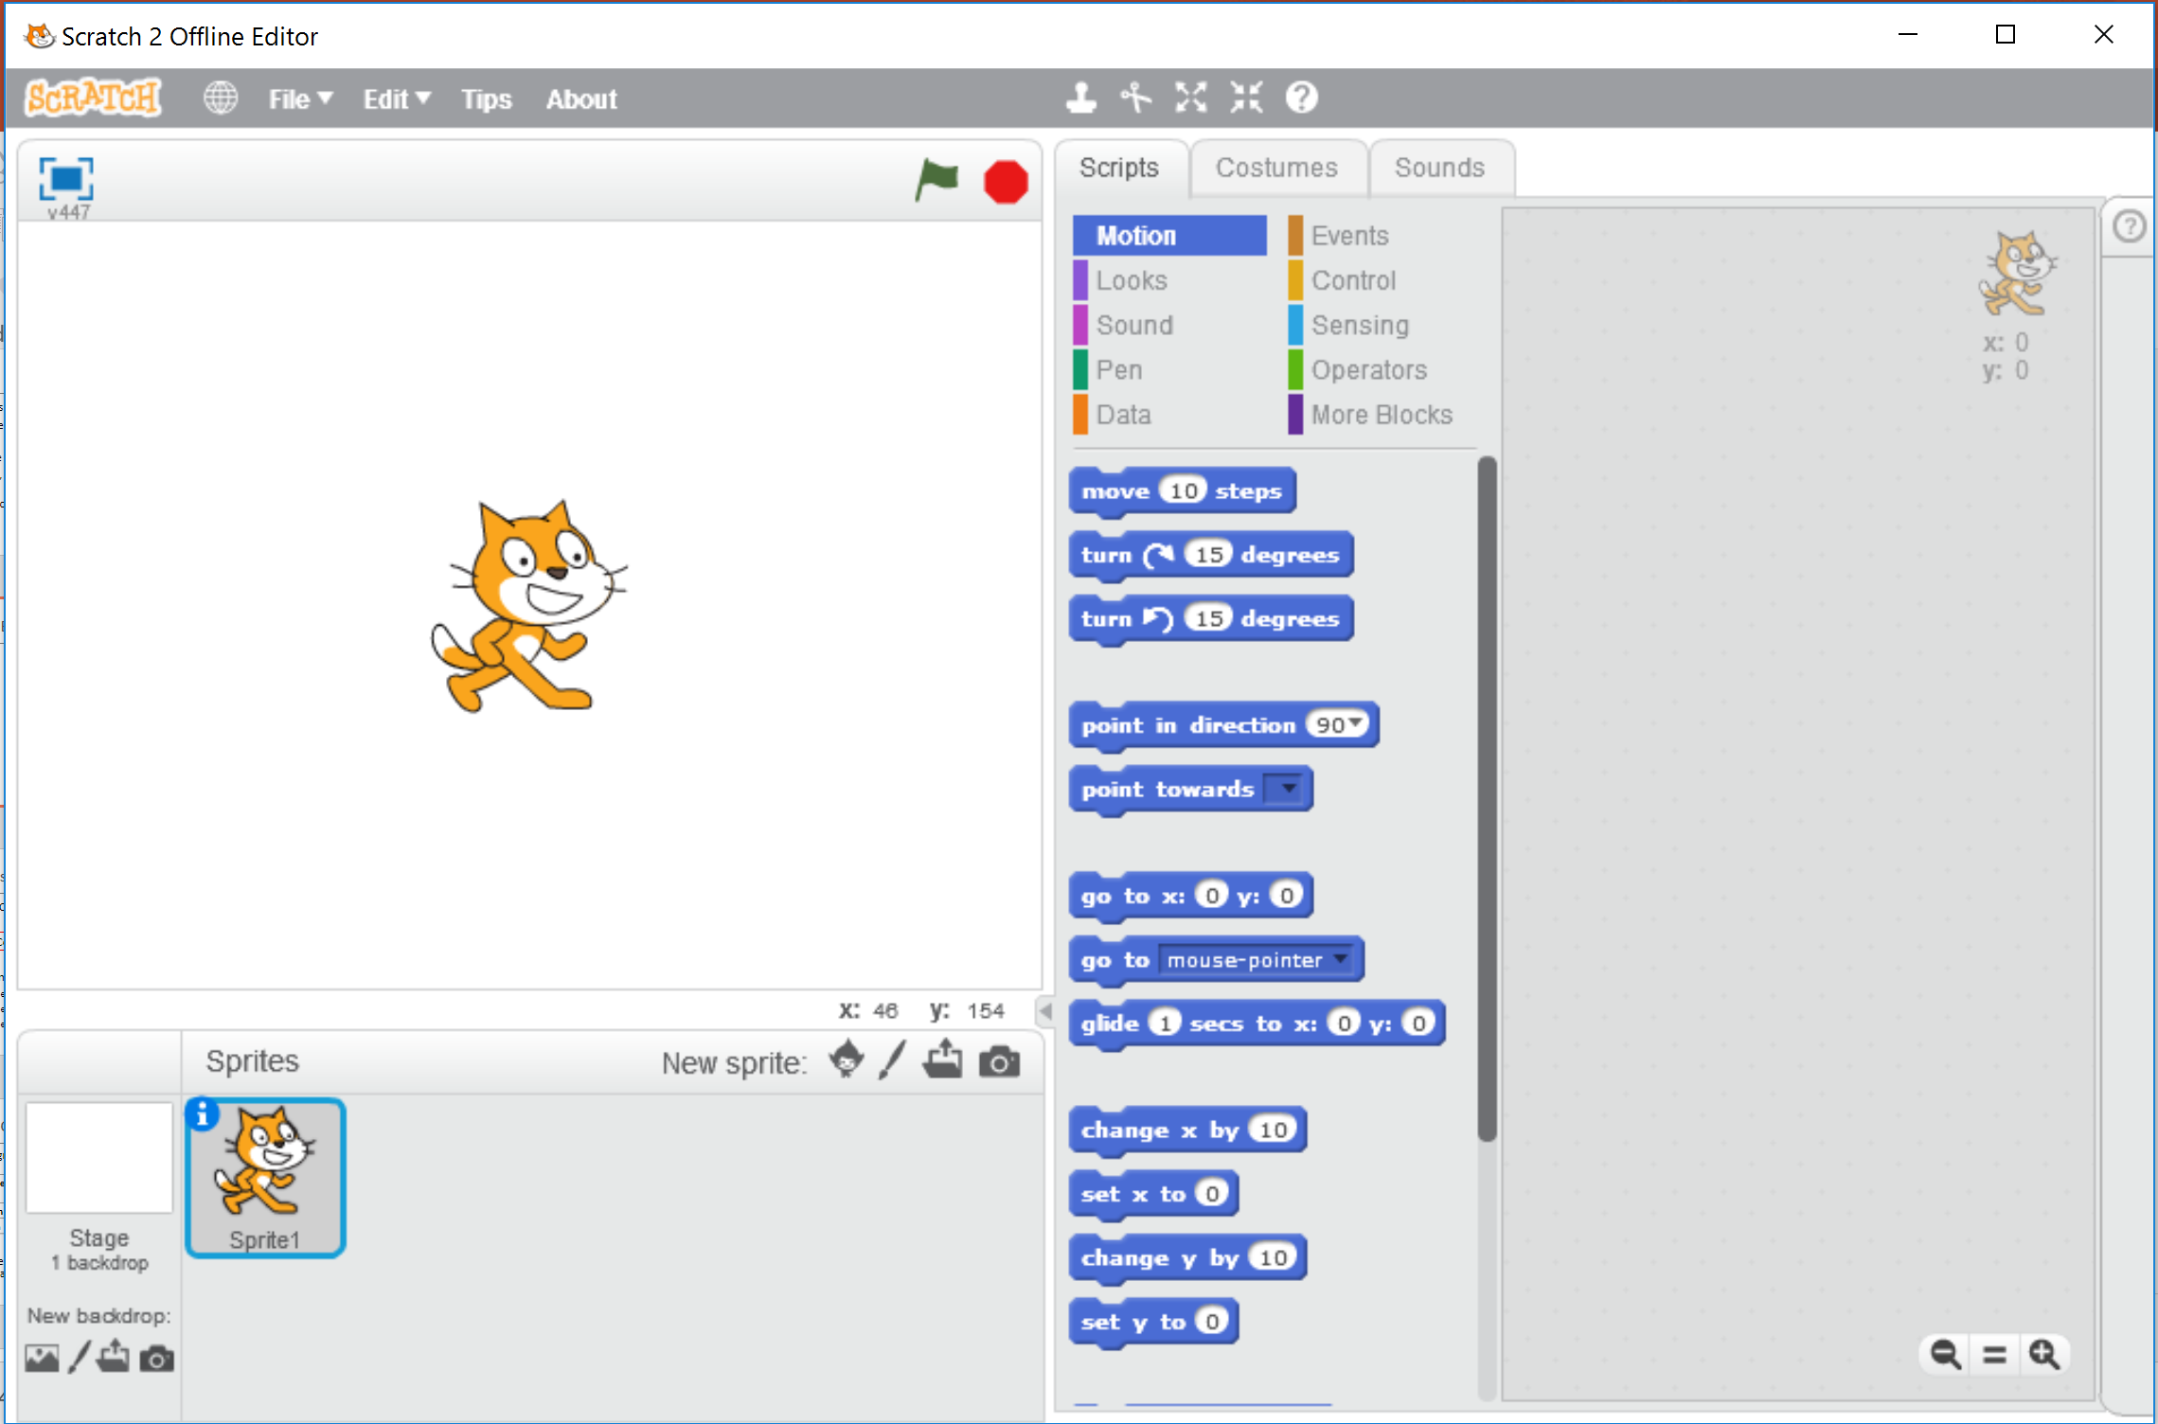
Scratch Editor Demo

Slide 6
Scratch
If you have a computer at home, you can:
download the Scratch from here: https://scratch.mit.edu/scratch2download/
work on the online version: https://scratch.mit.edu/projects/editor/?tip_bar=fly
Pre-installed on the Raspberry Pi.

Slide 7
Topics list
What is Scratch?
Flow of Control in a Program
SomethingFishy Examples:
Example1: Sequence
Example2: Sequence, Selection and Iteration.
Example3: Sequence, Selection and Iteration.

Slide 8
Flow of Control in a Program
Each program you write will typically have:
By using examples, we will explore what each of these mean.
Sequence | Things done in a particular order
Selection | Things done conditionally
Iteration | Things done repetitively
Vickers (2008)
Notes:
Vickers, P. (2008) How to Think Like a Programmer: Problem Solving for the Bewildered, Cengage Learning EMEA.

Slide 9
Topics list
What is Scratch?
Flow of Control in a Program
SomethingFishy Examples:
Example1: Sequence
Example2: Sequence, Selection and Iteration.
Example3: Sequence, Selection and Iteration.

Slide 10
Example 1
Demonstrating SEQUENCE

Slide 11
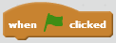
Events
Runs the program when the green flag is clicked
Source: Scratch help contents

Slide 12
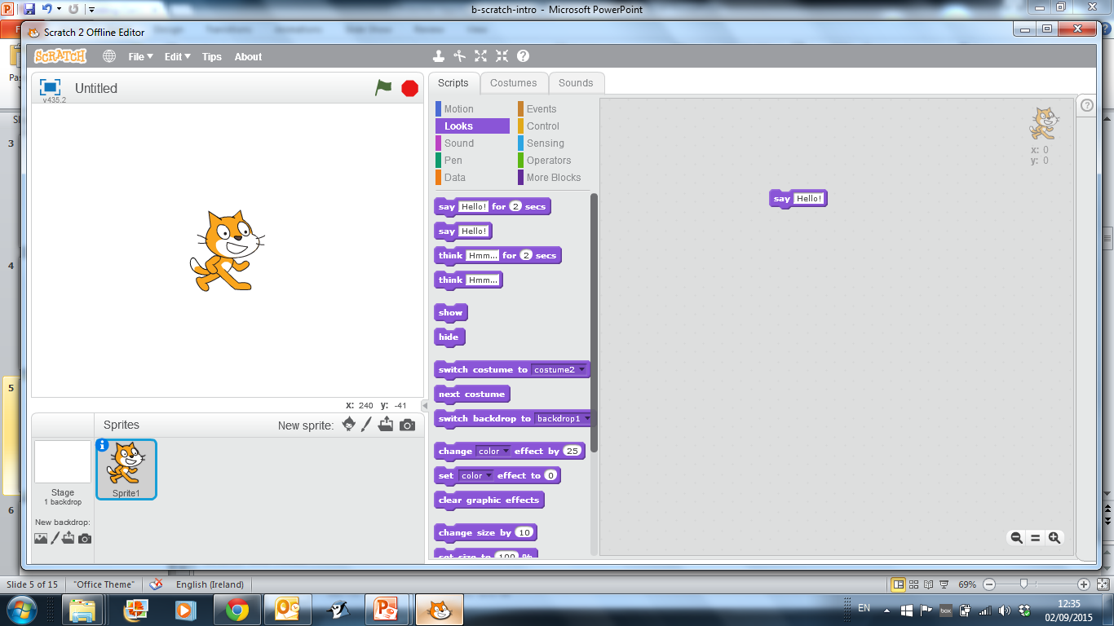
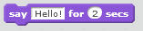
Statements
You can type in any text. The words will appear in a speech bubble for the sprite.
You can type in any words to say. The number of seconds tells the speech bubble how long to show. The program waits that long before continuing.
Source: Scratch help contents

Slide 13
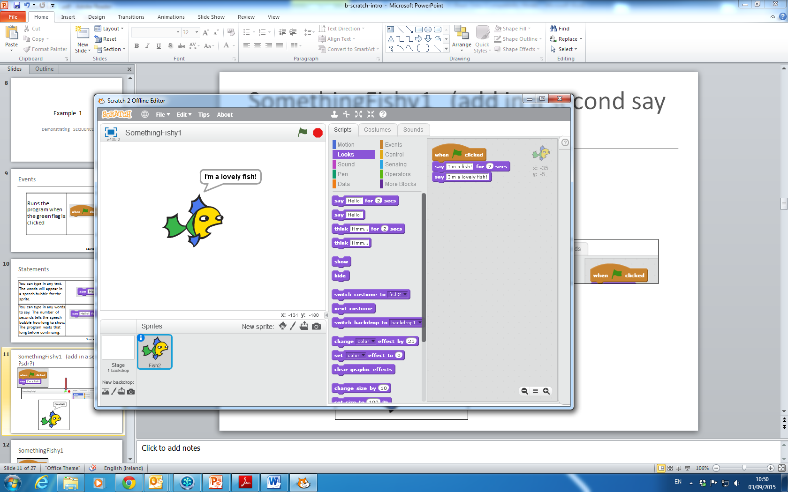
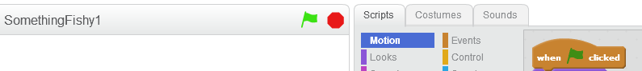
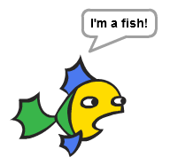
SomethingFishy1

Slide 14
SomethingFishy1
This example demonstrates
SEQUENCE
in a program.
The statements are executed in sequential order.

Slide 15
Example 2
Demonstrating
SEQUENCE, SELECTION and ITERATION

Slide 16
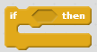
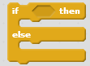
Selection / Conditions
If condition is true, runs the statements inside it.
If condition is true, runs the statements inside the if portion; if not, runs the statements inside the else portion.
Source: Scratch help contents

Slide 17
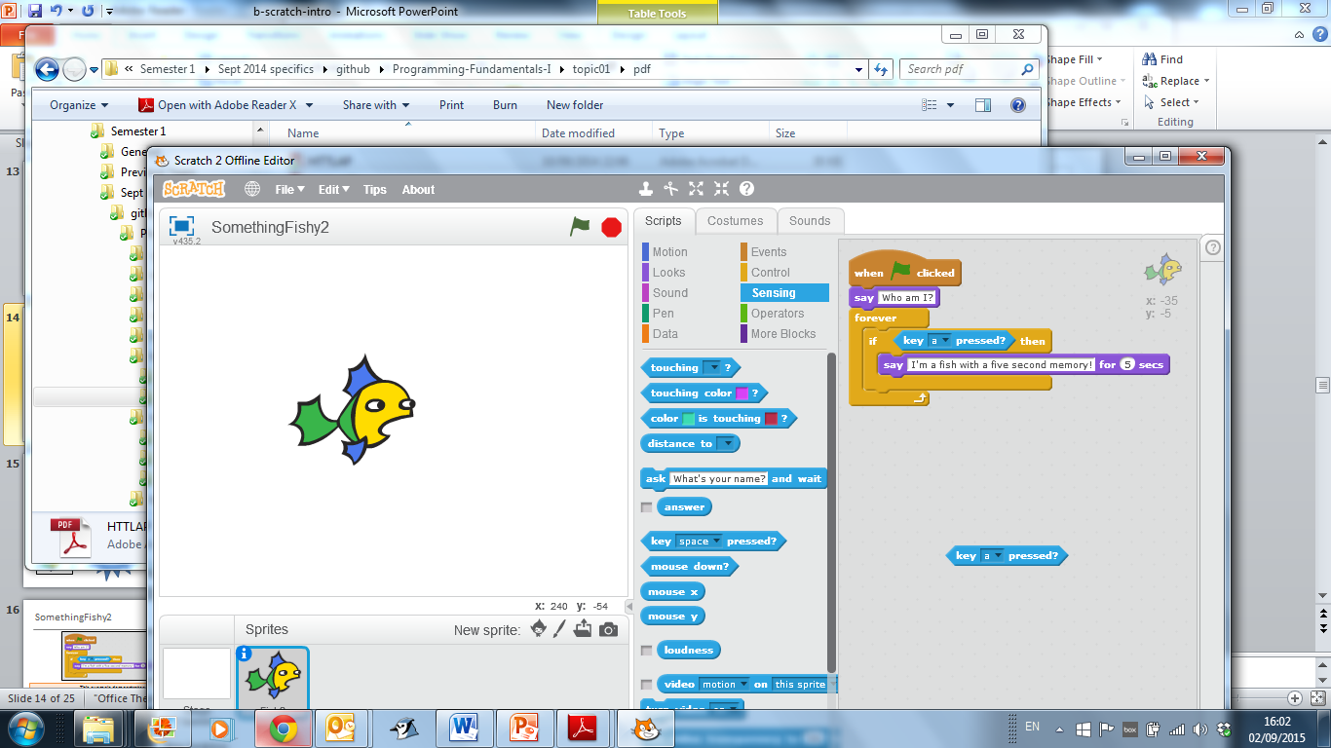
Example of a condition
Reports true if specified key is pressed.

Slide 18
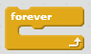
Iteration / Loops
Runs the statements inside over and over again
Source: Scratch help contents

Slide 19
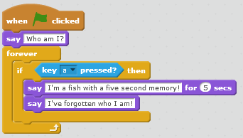
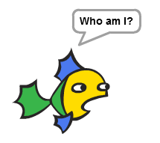
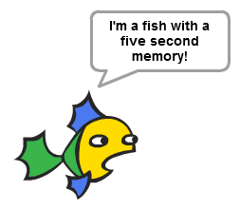
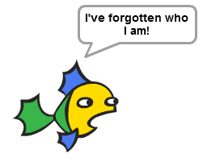
SomethingFishy2
If “a” is pressed on the keyboard

Slide 20
SomethingFishy2
This example demonstrates:
SEQUENCE (The statements are executed in sequential order)
SELECTION (if “a” is pressed on the keyboard, the messages are printed to the speech bubbles. If “a” is not pressed, nothing happens)
ITERATION (The program is continually listening/waiting for the “a” key to be pressed).

Slide 21
Example 3
More on
SEQUENCE, SELECTION and ITERATION

Slide 22
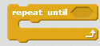
More Control / Loops
We saw this one in an earlier slide…it runs the statements inside over and over.
Repeat the statements inside until condition is true. Checks to see if condition is false: if so, runs the statements inside and checks condition again. If condition is true, goes on to the statements that follow.
Source: Scratch help contents

Slide 23
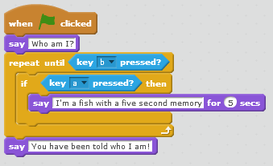
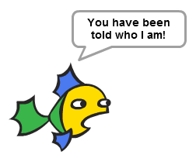
SomethingFishy3
Waiting for key to be pressed
If “a” is pressed on the keyboard
If “b” is pressed on the keyboard
Program Ends

Slide 24

Questions?

